Slide 1

Supply Chain Managent Dashboard
Supply Chain Management
Group 6 Presentation

Slide 2

Supply Chain
Management Dashboard
Supply chain management (SCM) is management of the flow of goods, data, and finances related to a product or service, from the procurement of raw materials to the delivery of the product at its final destination.
This Supply Chain Management Dashboard is a reporting tool used to track supply chain KPIs and metrics in a single display or interface. It track inventory levels, logistics management, and warehouse operations.

Slide 3
List of KPIs
1. Total Sales
2. Product Wise Sales
3. Sales Growth
4. Daily Sales Trend
5. State Wise Sales
6. Purchase Method Wise Sales
7. Payment Method Wise Sales
8. Product in Inventory
9. Store Wise Sales
10. Region Wise State

Slide 4
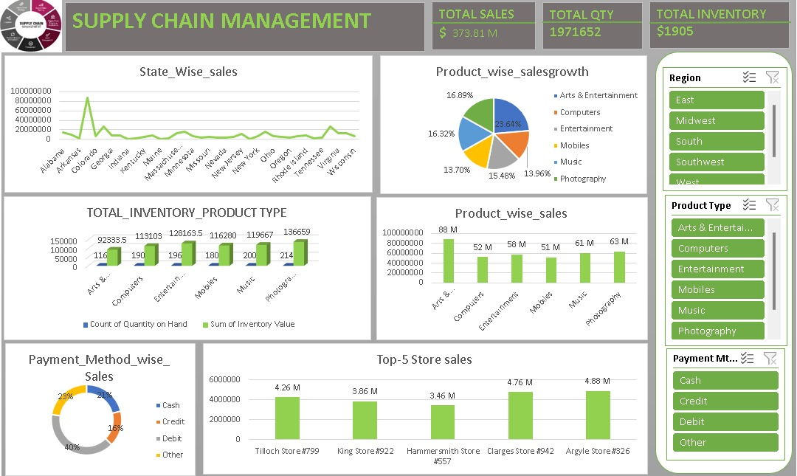
Excel Dashboard

Slide 5
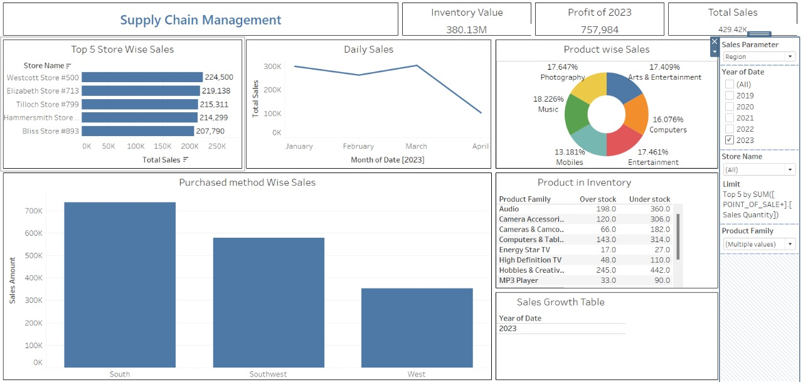
TABLEAU DASHBOARD

Slide 6
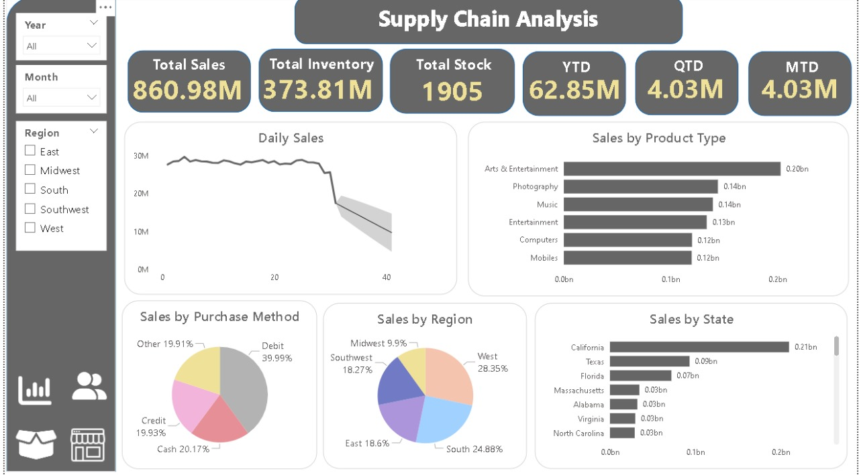
POWERBI DASHBOARD

Slide 7
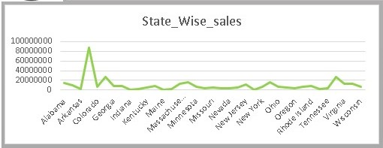
SUMMARY OF DASHBOARDS
The dashboard provides a detailed and visually appealing analysis of Sales.
The insights derived from the data can help in making informed decisions and strategies for sales acording to product type, puchase method, by region and by state.
State - wise sales
• The graph shows "State_Wise_sales," depicting the sales figures for various states.
• It highlights Colorado as an outlier with exceptionally high sales compared to the consistent and lower sales figures of the other states.

Slide 8
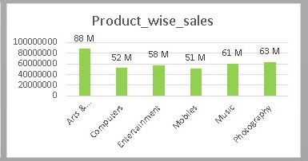
• Colorado has a significantly higher sales figure compared to other states, reaching close to 10,000,000.
• The sales figures for other states are relatively low and steady, without any significant spikes.
•After Colorado, the sales figures for all other states remain below 2,000,000, indicating a substantial disparity between Colorado and the other states.
Product - Wise Sales
• The graph displays "Product_wise_sales," showing the sales figures for different product categories.
• The category "Arts & Crafts" stands out with the highest sales figure, nearly reaching 90 million.
• The other categories have sales figures clustered between 51 million and 63 million, showing a moderate range of sales.
• "Mobiles" have the lowest sales among the listed product categories.

Slide 9
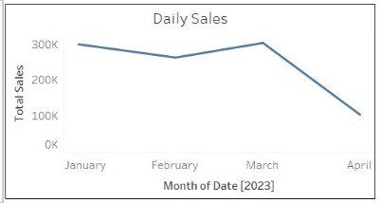
Daily Sales
• The graph displays "Daily Sales," showing the total sales over the months from January to April in 2023.
• It depicts generally declining trend in daily sales from January to April 2023.
• The highest sales were observed in January, followed by a slight decrease in February.
• March saw a brief recovery in sales, but April experienced a sharp decline, marking the lowest sales figure within the observed months.

Slide 10
SQL QUERY
--Table structure for table `f_inventory_adjusted`
DROP TABLE IF EXISTS `f_inventory_adjusted`;
/*!40101 SET @saved_cs_client = @@character_set_client */;
/*!50503 SET character_set_client = utf8mb4 */;
CREATE TABLE `f_inventory_adjusted` (
`Product Key` INT DEFAULT NULL,
`Product Name` TEXT,
`Product Type` TEXT,
`Product Family` TEXT,
`Product Line` TEXT,
`Product Group` TEXT,
`Product Description` TEXT,
`Sku Number` TEXT,
`Price` DOUBLE DEFAULT NULL,
`Cost Amount` DOUBLE DEFAULT NULL,
`Quantity on Hand` DOUBLE DEFAULT NULL
) ENGINE = InnoDB DEFAULT CHARSET = utf8mb4 COLLATE = utf8mb4_0900_ai_ci;
/*!40101 SET character_set_client = @saved_cs_client */;

Slide 11
KEY TAKEAWAYS FROM SCM DASHBOARD
• It provides a clear, real-time view of the entire supply chain, allowing stakeholders to track and monitor key performance indicators (KPIs) efficiently.
• With access to detailed and accurate data, managers can make informed decisions to optimize operations, reduce costs, and improve overall supply chain performance.
• The dashboard helps in pinpointing areas where delays, bottlenecks, or inefficiencies occur, enabling timely interventions to streamline processes.
• It provides a comprehensive tool for monitoring and optimizing the supply chain.
• It empowers businesses with actionable insights, promotes efficiency, and supports strategic decision-making to drive growth and competitiveness.

Slide 12
THANK YOU

